Slide 1
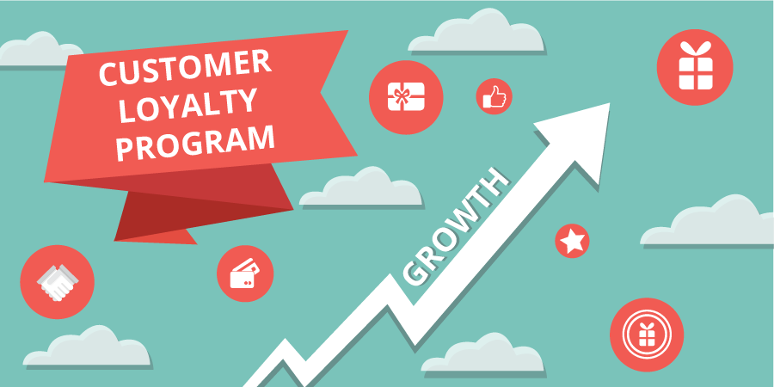
Loyalty Program Analysis in Retail Company

Slide 2
Introduction
Home World is a company engaged in the retail of building materials. Each customer has a membership card, where to join the loyalty program you can subscribe for $20/month. The program includes discounts, special offers, and gifts. As data analysts we have the task to check how effective the loyalty program is. We have to answer a few questions:
Is the average purchase for loyalty program users higher than for non-loyalty program users?
Is the purchase frequency for loyalty program users higher than for non-loyalty program users?
Test the hypothesis that the average purchase size is higher for loyalty program members than non-members.

Slide 3
Dataset Description
There are two datasets for the analysis. The first dataset named retail_dataset.csv consists of 105334 rows. It includes information such as unique identification number for each purchase transaction, unique identification number for each item purchased in the transaction, date and time of the purchase transaction since 1 of December 2016 till 28 of February 2017, number of items purchased in one transaction, unique identification number for each customer, unique identification number for each retail store and Indicates whether the customer is a member of the loyalty program or not.
The second dataset named new_product_codes.csv contains a unique identification number for each product and price per unit of the product and has 3159 rows.

Slide 4
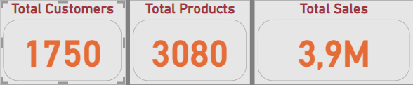
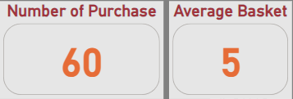
Key statistical indicators

Slide 5
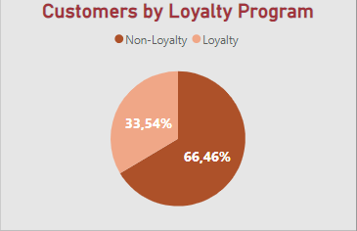
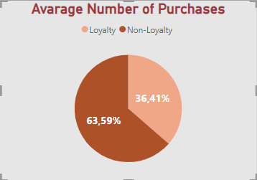
Loyalty Program Distribution
Only 33.6% or 565 users joined loyalty program. The majority of users have not used yet the loyalty program in their transactions.
Loyal customers have an average of 36 purchases per customer, while non-loyal customers have an average of 67 purchases per customer. The average purchase per non-loyal customer is greater than the average purchase per loyal customer.

Slide 6
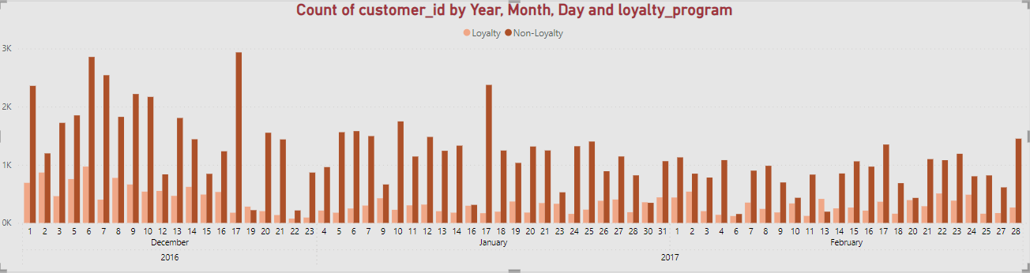
Number of Purchases per Day
Based on transaction data, only a small portion of transactions are made by customers who have a loyalty program. Customers without a loyalty program are always larger than customer transactions with a non-loyalty program except for the beginning of February.

Slide 7
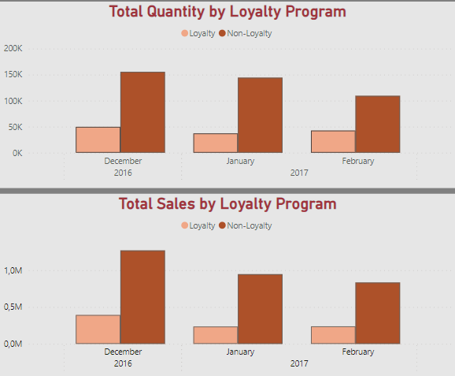
Total sales comparison
There is a difference between the total purchase and total sales between loyal and non-loyal customers. The total quantity and total sales non-loyal customer are greater than for loyal customer.

Slide 8
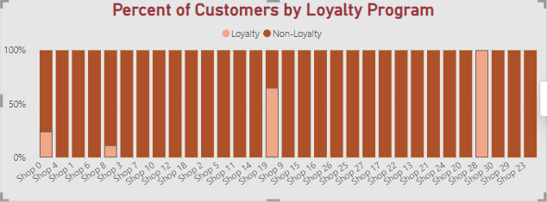
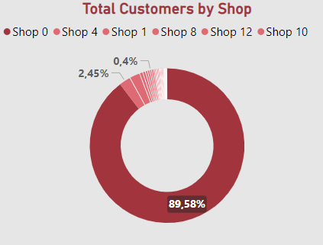
Number of Customers by Shop

Slide 9
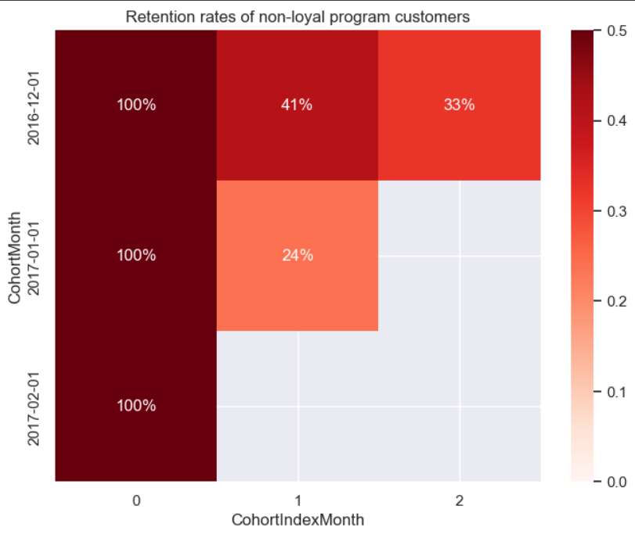
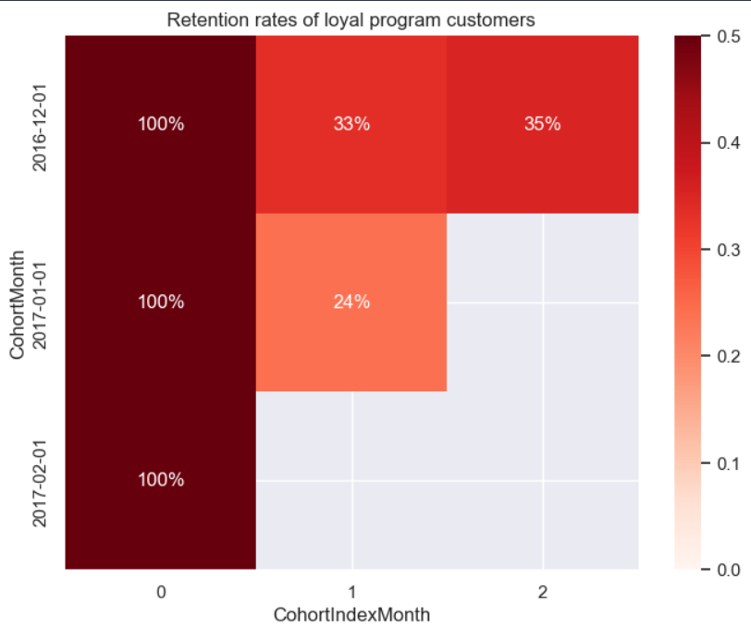
Retention Rate by Loyalty Program
Customer retention with a loyalty program does not show a better comparison than retention with users without a loyalty program.
Customer retention with a non-loyalty program is higher in the first month, namely 41% compared to users with a loyalty program, only 33% in the first month. Meanwhile, in the second month, users with a higher loyalty program were 35% and 33% without a loyalty program.

Slide 10
Mann–Whitney U-test: Statistic: 287020585.5 P-value: 1.047329884428723e-24 The null hypothesis is rejected
Hypothesis statement :
Null hypothesis (H0): There is no significant difference between the number of items between the loyalty member group and the non-loyalty member group.
Alternative hypothesis (H1): There is a significant difference between the number of items between the loyalty member group and the non-loyalty member group.
Based on p-value, we can conclude that there is a significant difference between the purchase size of loyalty program members and non-loyalty members.
We can reject the null hypothesis that the average purchase size is no significantly higher for loyalty program members than for non-members.

Slide 11
Mann–Whitney U-test: Statistic: 288274102.5 P-value: 3.29273366212733e-27 The null hypothesis is rejected
Hypothesis statement:
Null hypothesis (H0): There is no significant difference in total sales between the loyalty member group and the non-loyalty member group.
Alternative hypothesis (H1): There is a significant difference between total sales between the loyalty member group and the non-loyalty member group.
In this context, if the resulting p-value is smaller than the specified significance level, then we can reject the null hypothesis and accept the alternative hypothesis.
This will indicate that there is a significant difference in total sales between the loyalty member group and the non-loyalty member group.

Slide 12
Summary and Conclusions
Customers without loyalty programs always outweigh the transactions of customers with loyalty programs. Only 33.5% or 587 users participated in the loyalty program.
There is a difference between the average purchase per customer between loyal and non-loyal customers. Loyal customers have an average of 36 purchases per customer, while non-loyal customers - 67 purchases per customer.
The average size of basket with the loyalty program is greater than the non-loyalty program, which is 5.5 and the non-loyal program is 5.1. While the frequency of purchase for the loyalty program is smaller than that of the non-loyalty program.
Based on the statistical test results, it can be concluded that loyalty program members tend to have a significantly higher purchase size than non-members.
Customer retention with loyalty programs does not compare better to customer retention without loyalty programs. Customer retention without a loyalty program is higher in the first month, at 41% compared to users with a loyalty program, at only 33% in the first month. Whereas in the second month, users with the loyalty program were higher at 35% and 35% without the loyalty program.

Slide 13
Recommendations
We recommend making improvements or changes to the loyalty program because the frequency of purchases with the loyalty program is smaller than without the loyalty program. Although with the loyalty program, there is an increase in purchase size, but looking at the retention generated by the loyalty program is not significant with non-loyalty program retention. Some points that need to be re-evaluated are:
Member fees per month are around $20.
The amount of discount obtained by loyalty program members.
Ways to increase loyalty program users.

Slide 14
Thank You!

